Slide 1

Speak Fluently & Confidently B2- Course 1

Slide 2
Session 4- A Career Change
Part 1-: Considering a Career Change
( Listening)
Part 2: What would you say in the following
situations? ( More Idioms & collocations)
Part 3: Speaking Practice
https://befluent.me/

Slide 3
Session 4- A Career Change
Part 1-: Considering a Career Change
( Listening)
https://befluent.me/

Slide 4
Lesson 04: A Career Change
Phil is thinking about changing careers. Listen to his conversation with Andrew, and answer the comprehension questions. Then, learn the expressions they use.
For Phil, the worst part of a job interview is...
answering tricky questions
salary negotiations
talking about himself
The potential new job is ____________ Phil's current job.
better than
not as good as
about the same as
Which reason for leaving teaching does Phil NOT mention?
higher salaries elsewhere
long working hours
uncertain future of teaching
Phil specializes in...
consulting
math
programming
Andrew thinks the industry jobs Phil mentions are...
in high demand
not very interesting
unlikely to lead to promotions
Phil is mainly worried that...
he'll have a hard time finding employment
he will miss working with students
he won't enjoy working in industry
Andrew says that...
Phil should remain a teacher
Phil should try a different career
he doesn't know what to suggest to Phil

Slide 5



Conversation Text
Andrew: So, how’d your interview go?
Phil: I think it went pretty well. They seemed to like me.
Vocabulary
brag = talk about yourself and your accomplishments in an arrogant way
Andrew: Yeah? That’s great. You were super nervous about it.
Phil: I know. I hate interviews. I just don’t perform well when I’m the center of attention and I have to brag about my skills and stuff. It feels unnatural, and I always sound awkward.
awkward = strange, socially uncomfortable
being too hard on yourself = demanding too much from yourself
Andrew: I’m sure you’re being too hard on yourself, but I’m glad it went well. What’d you think about the job?
a step up = an improvement
Phil: It sounds like it has potential. It’d certainly be a step up from my current position. So, if it were just between those two choices, it’d be an easy decision. But I still have to consider other options.
toying with the idea
= casually considering the idea
altogether = completely
Andrew: What do you mean?
What brought this on? = What caused this?
Phil: Well… I’m toying with the idea of leaving teaching altogether.
Andrew: Really? What brought this on?

Slide 6



Phil: Well, higher education is just so unstable right now. College costs a huge chunk of change, and there’s been a major uptick in online learning… so who knows what’ll happen in the next ten or fifteen years? Plus, I can earn a
lot more in industry. It’s important to like your job and everything, but… passion doesn’t pay the bills.
Vocabulary
higher education = colleges and universities
a huge chunk of change = a lot of money
Andrew: Do you think your skills could easily transfer from academics to industry?
uptick = increase
Phil: Um, no, not directly… but having a Ph.D. proves that I’m at least somewhat competent, right? I dunno, I guess I’m just hoping and praying that companies have a use for someone with a math brain.
doesn’t pay the bills
= doesn’t provide enough money to survive/live
Ph.D. = doctorate degree
Andrew: Right. What areas are you considering?
hoping and praying
= greatly hoping
Phil: As far as I can tell, there’s currently a demand for data miners and actuaries.
as far as I can tell = based on the available information
Andrew: Yeah, I have no clue what those are.
I have no clue = I have absolutely no idea
Phil: Data miners sort through large amounts of information to find patterns, and actuaries use statistics to assess risk. For instance, actuaries work for insurance companies to calculate how much they should charge their clients.
patterns = repeating designs or events
assess = evaluate
Andrew: Hmm. It sounds kind of dull.
dull = boring

Slide 7



Phil: Tell me about it. That’s what worries me
– what if I make the transition and end up hating it? I don’t want to be stuck in a cubicle all day doing something that makes me miserable. And if I leave teaching, it might be really hard to go back. I don’t want to shoot myself in the foot.
Vocabulary
Tell me about it = You’re completely correct; I agree
Andrew: Well, good luck with that, buddy. I’m afraid I don’t have any words of wisdom for you. I’d hate to be in your shoes right now.
cubicle = small office area in a larger room; a “box” divided from the other office areas by temporary walls
shoot myself in the foot = accidentally cause damage to myself or my progress
words of wisdom = good advice
I’d hate to be in your shoes = I would not want to be in your situation

Slide 8
Vocabulary Quiz
Complete each sentence with a word from the box. Two words are not used.
altogether | awkward | hard on me | step up
as far as I can tell | bragging | hoping and praying | uptick
assess | dull | pattern | words of wisdom
After the adventure of a round-the-world trip, small-town life seemed extremely .
Before buying such an old building, we need a couple of experts to
_ it and see if it's structurally sound.
This milk is a day past its expiration date, but , it's still OK. Smells fine.
I went on a blind date and there were a lot of _ silences in the conversation. We probably won't go out again.
My cousin's always __ about how popular she is on
social media - I can't stand it!
Sheila, you've got the most experience. Do you have any
_ for us?
He played the guitar less and less over the years, and by the time he was 30 he'd stopped playing _ .
The in the country's growth is the result of developing relationships with new trading partners.
My parents were very _ when I was growing up.
They wouldn't settle for anything less than perfect.
The top of the cake is decorated with an elegant floral
_.

Slide 9
Speaking Task
Have you changed jobs or careers at some point in your life? Describe the transition and the factors that went into your decision. (Or, if you've never changed careers, talk about why you chose your current career and how you got your first job in it.)
Answers
Comprehension Questions
c
a
b
b
b
c
c
Vocabulary Quiz
dull
assess
as far as I can tell
awkward
bragging
words of wisdom
altogether
uptick
hard on me
pattern

Slide 10
Session 4- A Career Change
Part 2: What would you say in the following
situations? ( More Idioms & collocations)
https://befluent.me/

Slide 11
Session 4- A Career Change
To Throw Someone In At The Deep End
Meaning: to be given a difficult task without having much experience
Example:He was thrown in at the deep end as he had no previous experience in management.
In The Driver’s Seat
Meaning: to be in control of a situation
Example:
The CEO retired due to ill health. His deputy was appointed to replace him. He was now in the driver’s seat.
To Move The Goalposts
Meaning: to change the rules or the targets at any time without consultation
Example:
The Director gave the sales manager his sales target for 2020. However, after 4 months he increased the target by 20%. He moved the goalposts without discussion.
https://befluent.me/

Slide 12
Session 4- A Career Change
Turn over a new leaf
Meaning: To change the way you behave and become a better person. “Leaf” here is an old word meaning page of a book, so the idea is that you’re turning to a new, blank page in a notebook.
Example : Billy decided to turn over a new leaf and stop teasing his younger brother.
Take it one day at a time
Meaning: To deal with each day’s problems as they happen, and not worry too much about the distant future
Example : Giving up meat can be tough, but take it one day at a time, and you’ll realize you can do it.
Make a fresh start
Meaning: To take the opportunity to begin something again
Example : I’m looking forward to making a fresh start this term, training harder, and getting back on the basketball team.
If you do a cushy job, it is very easy, usually fun and doesn’t require much effort at all.
If a person says they are between jobs, they are saying they currently don’t have one.
https://befluent.me/

Slide 13
Session 4- A Career Change
Part 3: Speaking Practice
https://befluent.me/

Slide 14
Session 4- A Career Change
What are some of the worst jobs you can think of?
What are some of the best jobs you can think of?
How long do you want to work?
Is it better to be a boss or an employee? Why?
What would be the most satisfying job for you?
What is one of the most exciting jobs you can think of? How about one of the most boring jobs?
What kind of job do you want to get in the future? What kind of tasks will you have to do?
Do you think what job someone has determines who they are?
What is the most dangerous job?
Why is it difficult to get a job in Egypt?
https://befluent.me/

Slide 15
Session 4- A Career Change
Have you ever had a part-time job? What was it?
Have you ever been fired or laid off? Why did it happen?
Would you prefer to work indoors or outdoors?
What jobs are well-paid and badly paid in your country?
Do your parents have a say in what job you choose?
https://befluent.me/

Slide 16
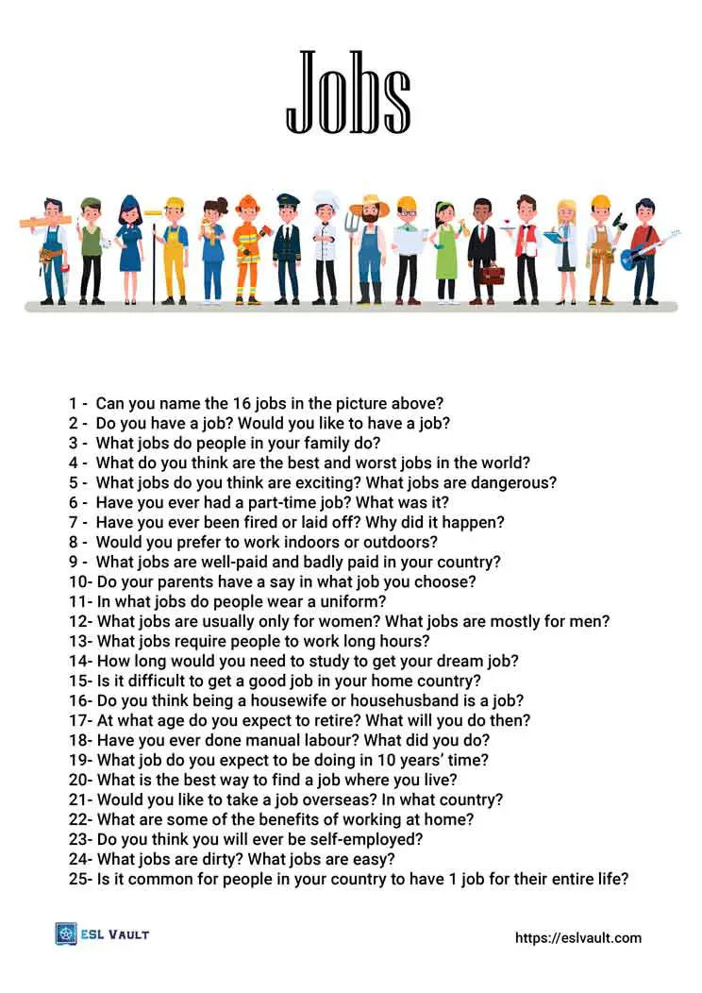
Session 4- A Career Change
https://befluent.me/

Slide 17
Session 4- A Career Change
Thank you!☺
https://befluent.me/

